Slide 1




CS 576
DEPENDABLE SOFTWARE SYSTEMS
COLLEGE OF
COMPUTING & INFORMATICS
RESEARCH PAPER
PRESENTATION
CLEANROOM SOFTWARE ENGINEERING PROCESS
BY VIKRAM SRI NITESH TANTRAVAHI
Drexel ID: 13247361
Notes:
To view this presentation, first, turn up your volume and second, launch the self-running slide show.

Slide 2
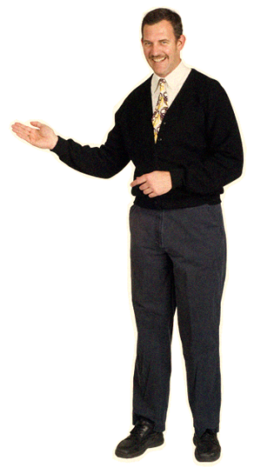
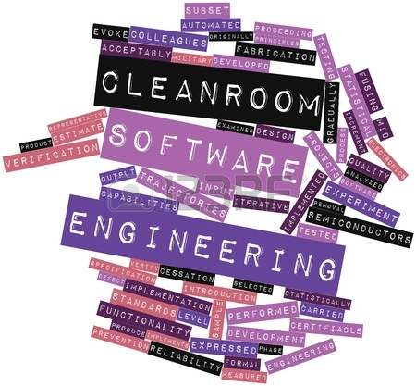
INTRODUCTION
It is a process that develops software with a certifiable level of reliability.
Developed by Harlan Mills in early 1980’s at IBM
It is a theory-based, team oriented software development process and a certification of high-reliability software systems under statistical quality control.
The main objective of the Cleanroom process is developing software that exhibits zero failures while in use.
Cleanroom is a modern approach to software development.
Improvises both the productivity of developers who use it and the software quality they produce.
Notes:
Give them those things in a clear, easily understandable way…

Slide 3

The main goal of the Cleanroom process is to develop software, which has no defects or errors or bugs right after the development itself i.e., even before any testing is performed.
- Manageable Development
Maintenance of intellectual control of software development by the managers and the technical teams is a very important aspect in software development.
- No Failures in Use
In Cleanroom, development teams use rigorous specification, design, and verification practices, coupled with testing practices that provide valid measures of development performance in approaching the goal of zero defects.
GOALS
Notes:
But don’t hide behind your slides.

Slide 4
DEFINING ELEMENTS OF CLEANROOM
There is a set of defining elements or major technologies that uniquely characterize the Cleanroom Software Engineering
INCREMENTAL DEVELOPMENT Incremental development plan organizes a Cleanroom project into an orderly sequence of development cycles, with some amount of end user function developed in each cycle.
FUNCTIONAL SPECIFICATION The specification team creates the Functional Specification document to satisfy the software requirements.
Black Box
State Box
Clear Box
DESIGN AND VERIFICATION
QUALITY ERTIFICATION

Slide 5













CLEANROOM SOFTWARE ENGINEERING REFERENCE MODEL
MANAGEMENT
SPECIFICATION
DEVELOPMENT
CERTIFICATION
Notes:
Your audience deserves to be treated like royalty. Design a presentation that meets their needs, not just yours.

Slide 6
The Cleanroom Software Engineering Reference Model (CRM), is usually represented in terms of set of 14 Cleanroom processes, which results into 20 work products.
CLEANROOM MANAGEMENT PROCESS
Project planning
Project Management
Performance Improvement
Engineering Change
2. CLEANROOM
SPECIFICATION
PROCESS
Requirement Analysis
Function Specification
Usage Specification
Architecture Specification
Increment Planning
3. CLEANROOM
DEVELOPMENT
PROCESS
Software Reengineering
Increment Design
Correctness Verification
4. CLEANROOM
CERTIFICATION
PROCESS
Usage Modeling and Test Planning
Statistical Testing and Certification

Slide 7

















PROS
&
CONS
ADVANTAGES
&
DISADVANTAGES
Notes:
The last rule is: Cultivate healthy relationships (with your slides and your audience)

Slide 8



ADVANTAGES
1. Some of the benefits through the use of Cleanroom are like, the code verification becomes much faster and a deeper understanding of the requirements, design and code.
2. The more the time an individual or a company spends on to come up with a sound design, the less time one will spend translating such design into code.
3. The programs that are built with it are of much more higher quality than compared to the programs built without the process.
4. There is a very high probability of low rate of defects in a program attributed to the way that Cleanroom uses statistical usage testing.
5. This methodology is incremental so it can be implemented gradually.
Notes:
Allows you to connect eye-to-eye with your audience in a meaningful way.

Slide 9

1. The time it takes to train a team to the point where they are effective and efficient at verifying designs might be too long and expensive.
2. The Cleanroom is something very different from the usual stuff and very out of the norm, and so extreme, that the required drastic change of culture would be so much for the companies to handle.
3. The resources required to train the staff to this level of standard would be beyond the acceptable level.
4. High risks and challenges involved for a company to just try out this process.
DISADVANTAGES
Notes:
Letting go is hard, we know.

Slide 10


CONCLUSION
Cleanroom software engineering allows errors to be found earlier in the lifecycle, which minimizes expensive rework later on and speeds time to market. Designs are simplified, straightforward, and verifiable, resulting in less "spaghetti" code. Quality is achieved by design and verification, not testing. This built in quality lowers the overall cost of the product, and the designs also tend to be more concise and compact than average; always a good thing for embedded developers.
Notes:
They’re there to see you. To be inspired by your message…

Slide 11









It is a formal, disciplined process, and composed of a set of stepwise refinements or transformations from the requirements to the code, where each transformation is verified to the previous level of refinement in order to minimize errors. It mainly aims at better way of software development.
THANK YOU
Notes:
Combining minimal text with meaningful visuals means that you’ll reach everyone.

